Slide 1
ATM Project using Spring Framework
Fresher Java K30_ Mock project

Slide 2
Agenda
About team
Validation
Withdraw
1
2
3
4
5
6
Overview
Check balance
Conclusion

Slide 3




Our team
Lê Văn Phú
PhuLV1
DUT
Phan Xuân Mạnh
ManhPX1
HCMUAF
Trần Anh Quân
QuanTA5
UIT
Mai Văn Hải
HaiMV
HCMUAF

Slide 4
Overview
About project
Object:
-Build an ATM simulator application
-Understand software development process, MVC architecture
-Study new technology
Technology:
-Spring MVC
-Hibernate
-MySql database
Tools:
-Spring Tool Suite
-XAMP
-Tortoise SVN

Slide 5
Overview
Use case diagram

Slide 6
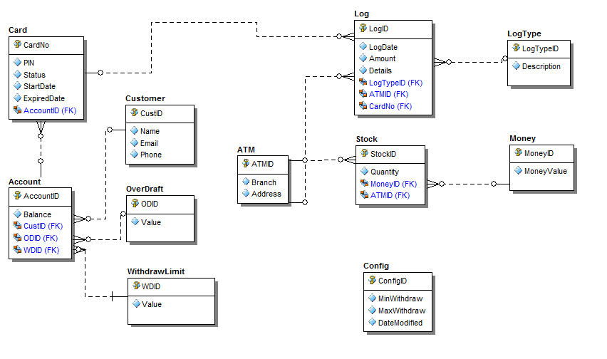
Overview
Entity Relationship diagram

Slide 7
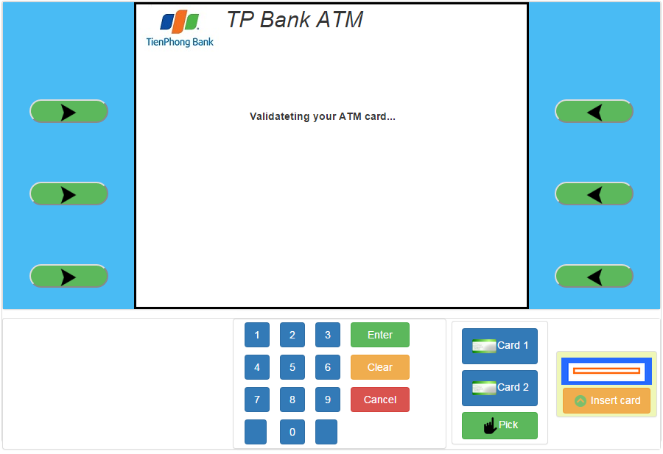
Overview
UI

Slide 8
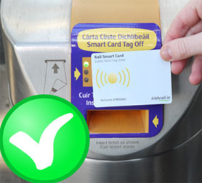

Validation
Validate card
Authenticate user

Slide 9
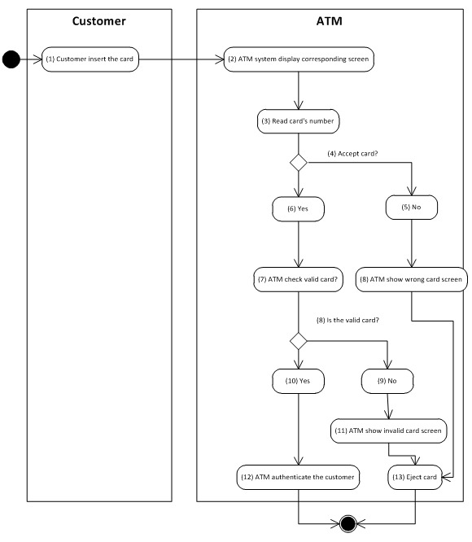
Validation
Validate card
Activity diagram

Slide 10
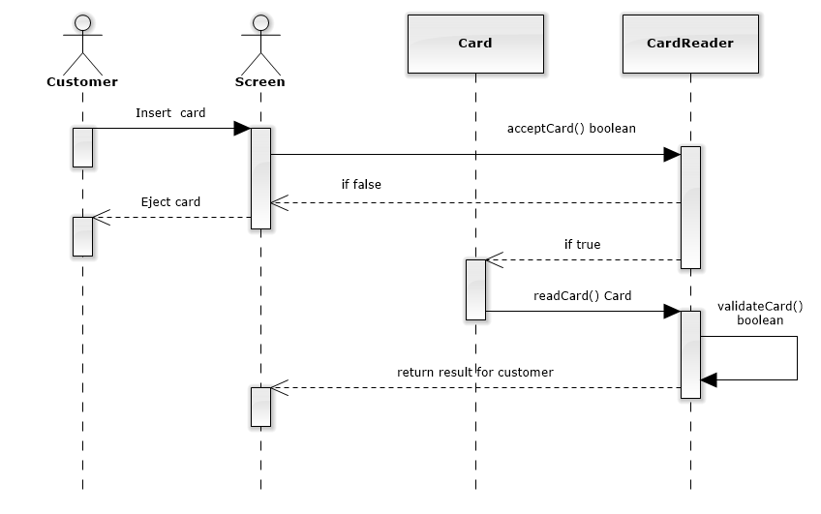
Validation
Validate card
Sequence diagram

Slide 11
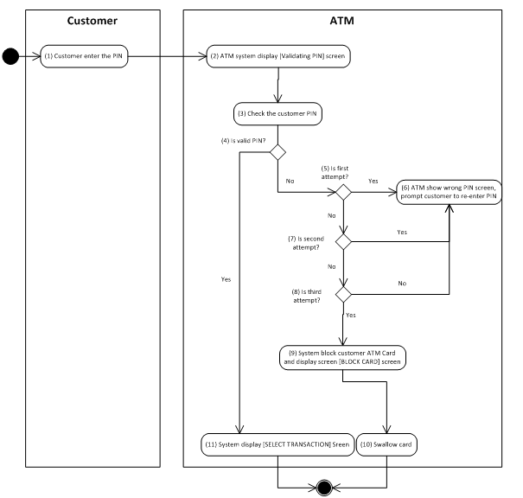
Validation
Authentication
Activity diagram

Slide 12
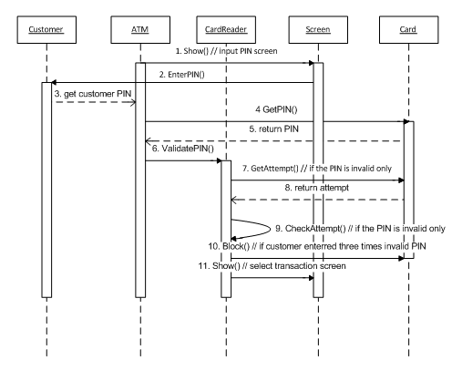
Validation
Authentication
Sequence diagram

Slide 13
Validation
Advantage
Difficult
SRS Document provide very detailed
The help of people with experience
Sociable group and help each other
Problem with bean and session of spring Framework
Query data with Hibernate Framework
Rollback data when run Junit

Slide 14
Check balance
1. Use Case
Name | CheckBalance
Description | This use case allows Customer to check their Balance.
Actor | Customer
Trigger | When Customer click “Check balance” button in MainScreen
Pre-condition | Customer had Validation to ATM.
Post-condition | ATM system display balance of Customer.

Slide 15
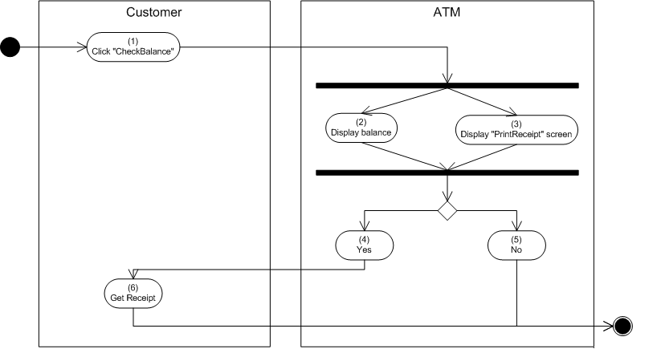
Check balance
2. Activities flow

Slide 16
Check Balance
Advantage
Difficult
Function simple
Query data with Hibernate Framework

Slide 17
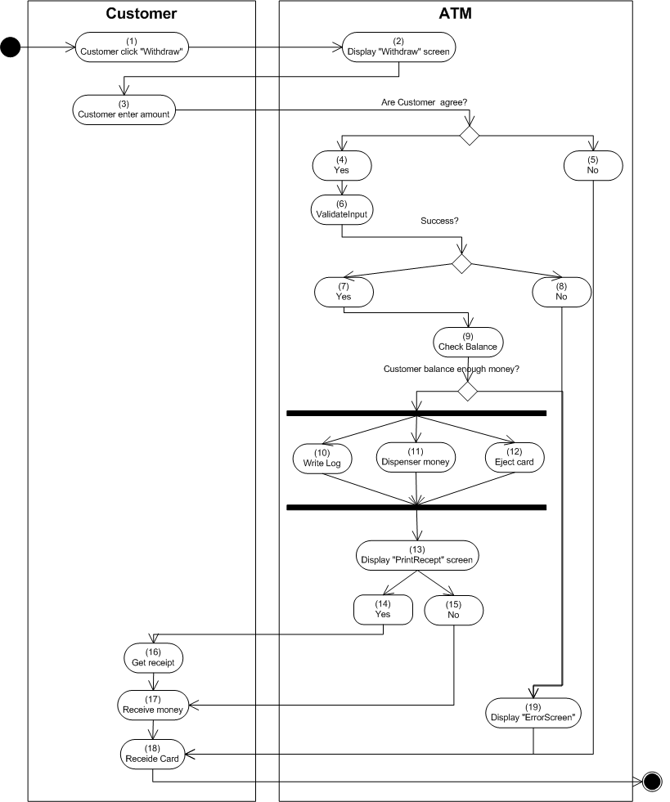
Withdraw
Activity diagram

Slide 18
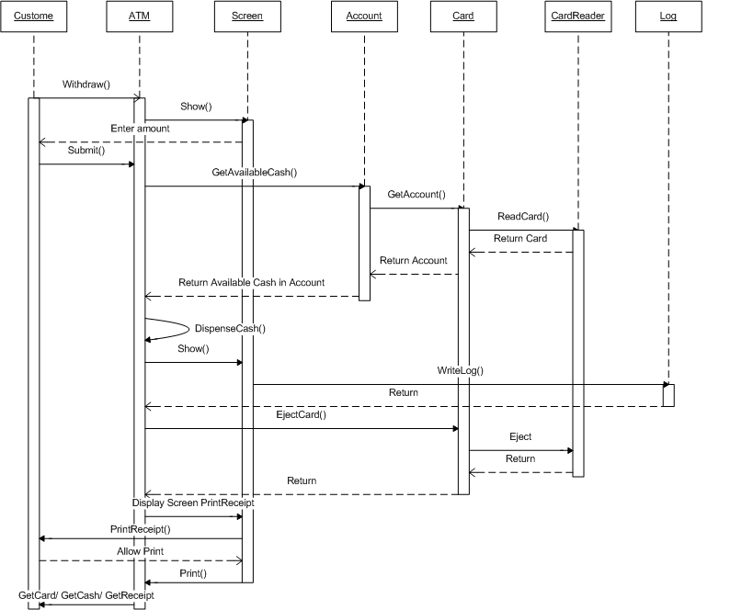
Withdraw
Sequence diagram

Slide 19
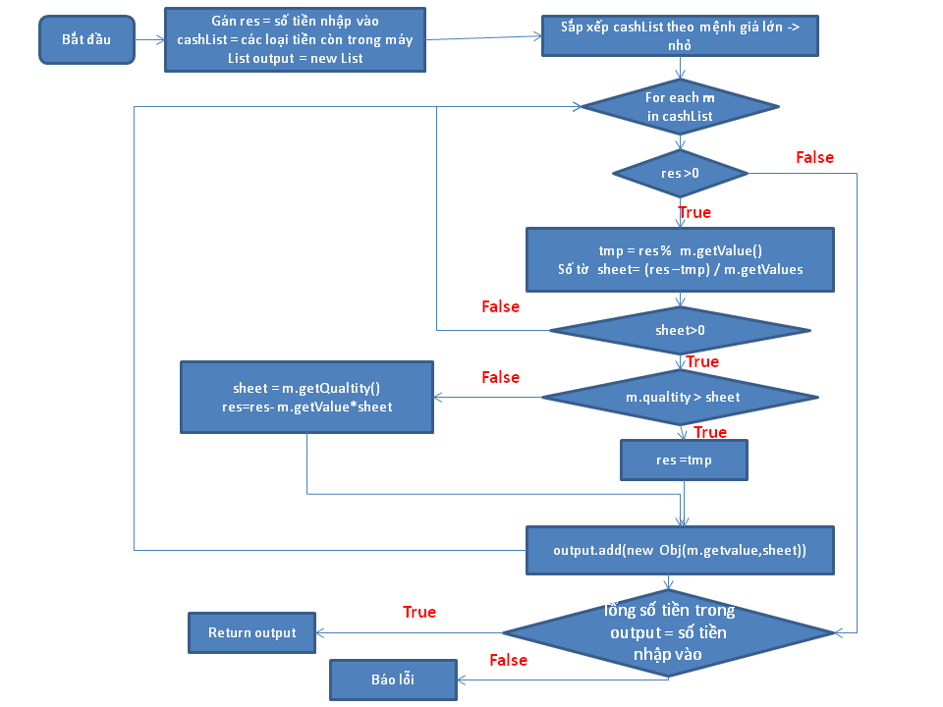
Withdraw
Dispenser money

Slide 20
Withdraw
Advantage
Difficult
Sociable group and help each other
Query data with Hibernate Framework
Withdraw function relative to others funtions
SRS not clear

Slide 21
Conclusion

